Slide 1
Focus on Iris: How data is used for the certification and operational phases of a satellite-based air traffic communication system for Europe
Céline Pasty
London, 14 April 2016

Slide 2
The existing maritime safety services

Slide 3
Some terms
IMO International Maritime Organization
SOLAS Safety Of Life At Sea
GMDSS Global Maritime Distress and Safety System
Inmarsat International Maritime Satellite Organization
IMSO International Mobile Satellite Organization

Slide 4
Inmarsat maritime safety services
Inmarsat is the ONLY provider of GMDSS-approved satellite communications systems. They are:
Inmarsat B (launched in 1993, will close end 2016)
Provides voice, fax, data communications
Inmarsat C (launched in 1991)
Provides data only store and forward messaging
Inmarsat Fleet (launched in 2002)
Provides voice, fax, data communications

Slide 5
Inmarsat-3 satellite coverage

Slide 6
An Inmarsat-C terminal

Slide 7
High-level satellite system
Space segment (to provide communication links with the earth)
Ground segment (to control and maintain the space segment)
Maritime mobile terminals (to communicate with the users)
Terrestrial networks (to support connectivity with the land-based users)

Slide 8
GMDSS requirements
Functional requirements;
Network availability;
Requirements on processes.

Slide 9
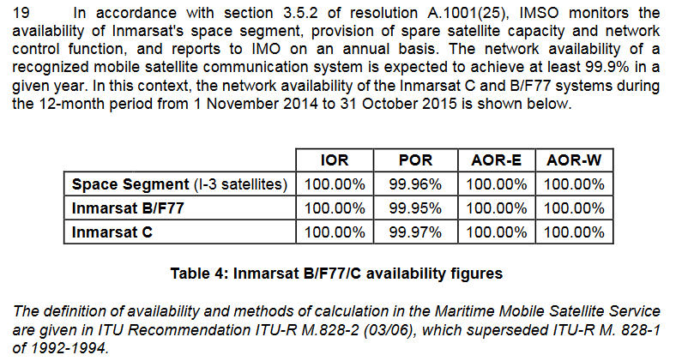
IMSO report

Slide 10
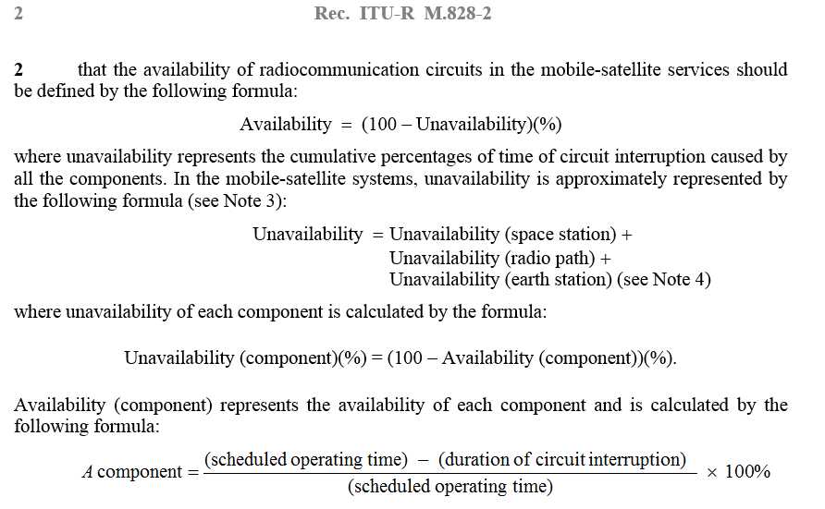
Definition of Network Availability

Slide 11
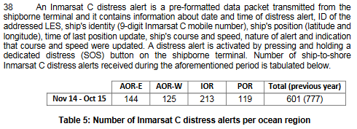
IMSO report

Slide 12
Iris: a new aero safety service

Slide 13
Air Traffic Control

Slide 14
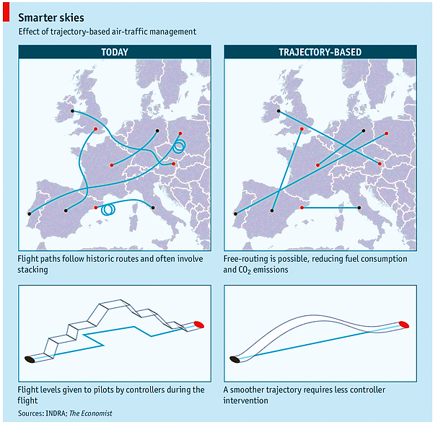
Trajectory-Based Operations
14

Slide 15
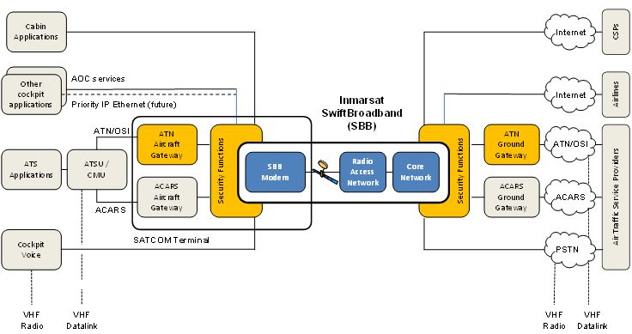
IRIS: A satellite datalink for Air Traffic Management
A European project sponsored by ESA, aligned with the EC SESAR Programme
To complement the terrestrial infrastructure initially
Iris Precursor: 2018-19
Iris Service Evolution: 2028-29
Based on evolution of Inmarsat SwiftBroadband infrastructure
15

Slide 16
Requirements
Network availability;
Latency;
Operational visibility;
Requirements on processes.

Slide 17
Thank you

